Slide 1
HOW DOES MUSIC AFFECT YOUR MEMORY?
School: Mileniumi i tretë
Project week

Slide 2
Does music affect you?
Research has shown that music does affect you in many different ways.
Some of them are positive and some of them are negative.
Why exactly that happens will be discussed later on.

Slide 3
What ways does it affect you?
It can affect you in many ways like mentally and physically.
Today we will focus on the ways it affects you mentally, or, more exact, how it affects your memory.

Slide 4
Pros and Cons

Slide 5
Pros
When you listen to music, it stimulates the hippocampus, which handles long-term memory storage.
That stimulation reduces stress and helps you relax, making it easier to remember things.

Slide 6
Cons
In some cases music can make you lose focus or distract you from what you're doing.
If it actually distracts you is completely based on your personality.

Slide 7
Statistics

Slide 8
These will be the results of some tests that we performed during this week.
The test that we performed was fairly simple.
They will show you how much music affects you.
And if fast, slow or no music is better.

Slide 9
No music

Slide 10
Slow music

Slide 11
Fast music

Slide 12
Results
 | Avg. | % | Most guessed word
No music | 12 | 50% | Fron
Slow music | 7 | 29% | Flokë
Fast music | 6 | 25% | Anije

Slide 13
Personal results
 | No music avg. | Slow music avg. | Fast music avg.
Ardi | 12 | 15 | 15
Hana | 10 | 12 | 15
Drin | 14 | 14 | 14
Blendina | 8 | 8 | 8
Linor | 7 | 8 | 6

Slide 14
Dictionary
pros = the good thing about something.
cons = the bad thing about something.
Coordinator = a person that organises a group.
Avg. = average

Slide 15
Credits
Coordinator
Photographer
Research
Testers
Teachers
Sources
Thank
Ardi Loxha.
Hana Krasniqi.
Drin Krasniqi.
Blendina Beqiri, Linor Tahiri.
Jeta Kingji, Krenare Lleshi, Malsore Reka.
http/:velodyne.com; www.percantagecalculator.net
you

Slide 16
Extras

Slide 17
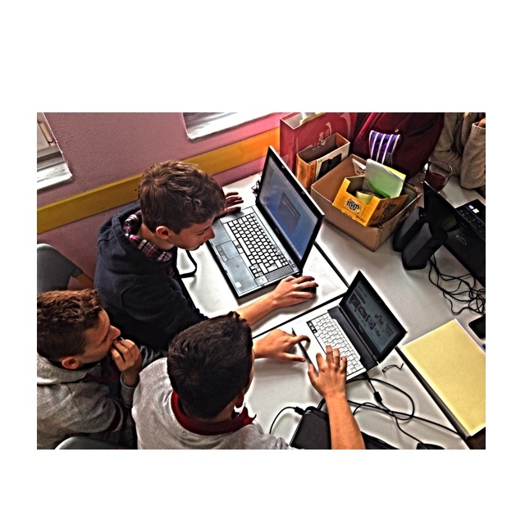

Slide 18
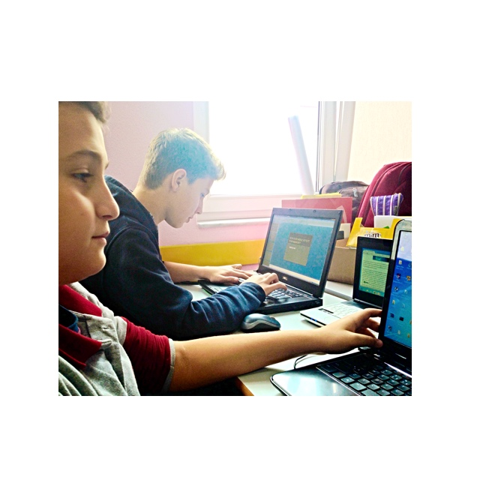

Slide 19
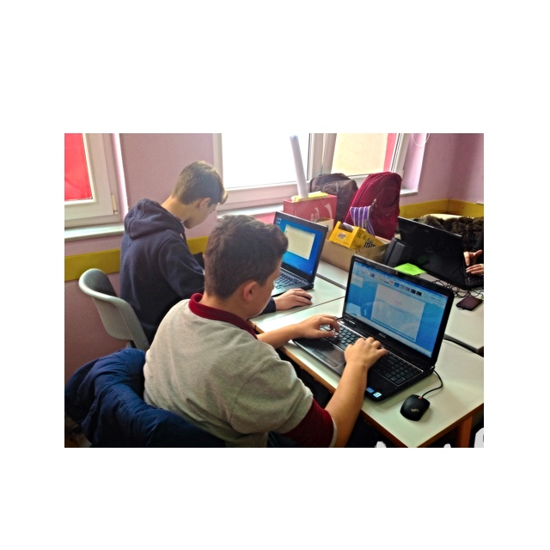

Slide 20
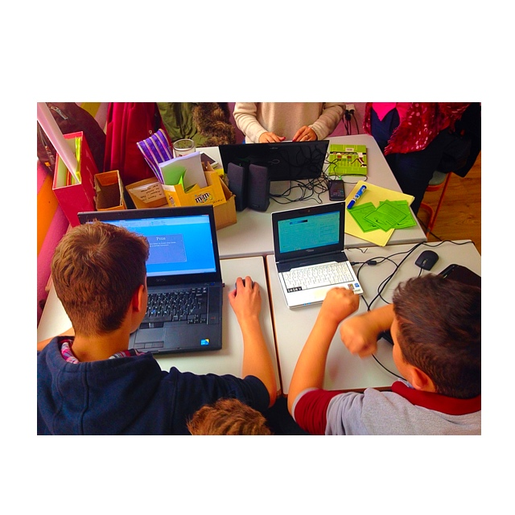

Slide 21
